Slide 1
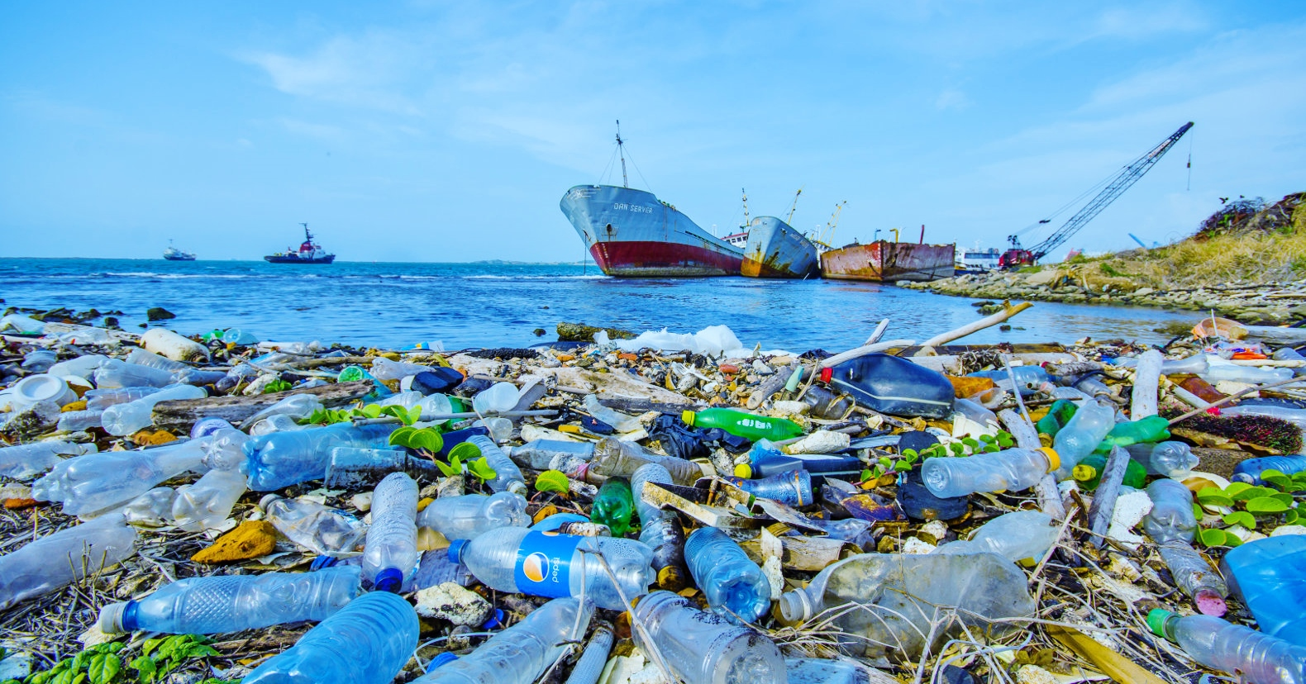
OUR PLASTIC PLANET: Growing by the day
Microplastics are taking over our environment, polluting the air we breathe, starving wildlife, and poisoning our food and water supplies. They pose a threat we cannot ignore. Help us celebrate Earth Week by learning about this environmental problem and how–
and if--we can stop it.
April 22, 2026: film on The Plastic Problem, discussant: Chris Phillips
Chris is Operations Manager of Orchard Hill Landfill/Bestway Disposal in Watervliet
April 29, 2026: Talk on Tiny Particles, Big Problems byTami Renkoski, CIH
Tami has 32 years of experience in the field. She will present an overview of microplastics, what they are and where they come from, health effects, ways to limit exposure, gardening techniques, and current legislation introduced in the Michigan House and Senate.
Both events will be at Lake Michigan College-South Haven, 7 to 9 pm
refreshments at 6:30, followed by discussion
Admission is free. Registration is not necessary but if you plan to come, please send an email to drzintakonrad@gmail.com and ask any questions you may have.
Sponsored by the Earth Friendly Committee of the South Haven Garden Club

